Slide 1
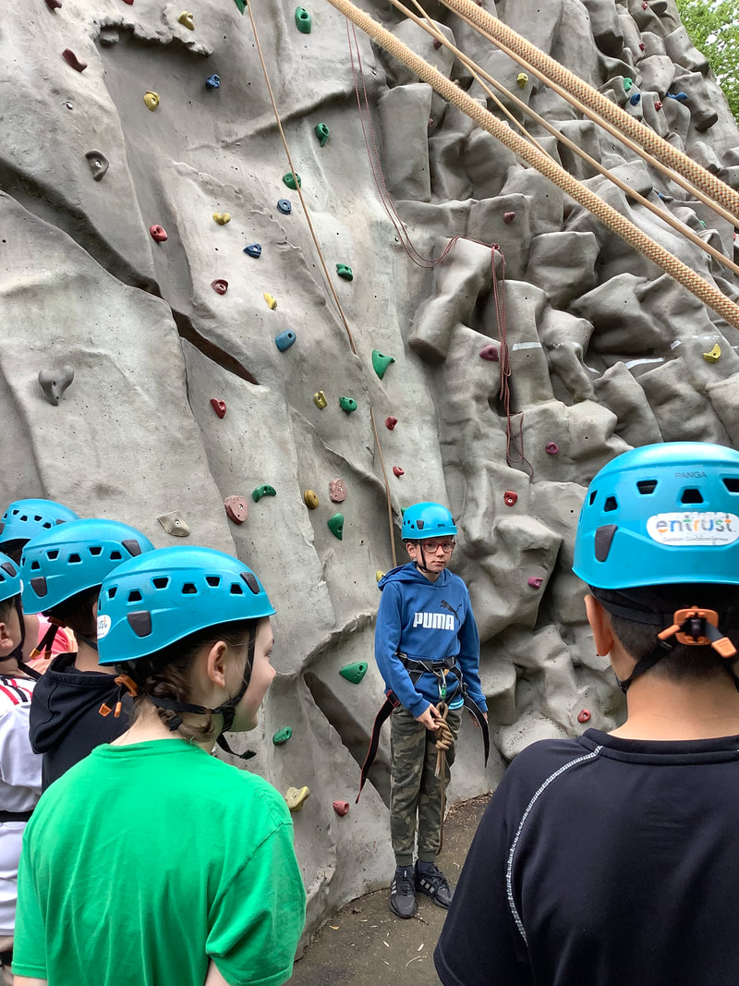
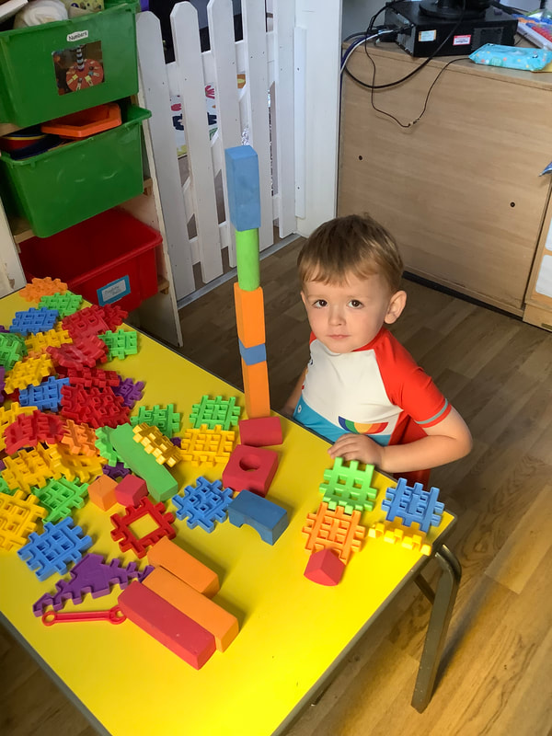
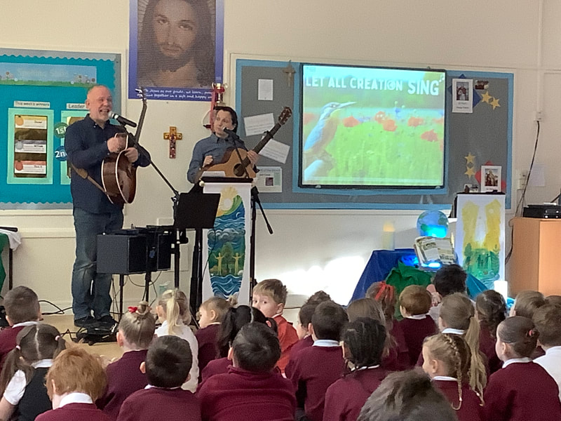
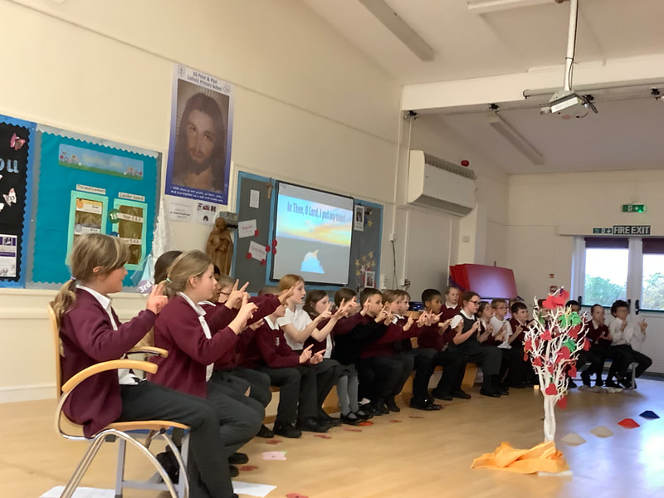
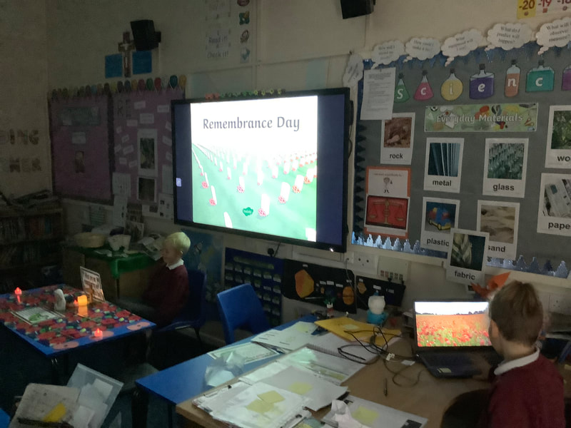
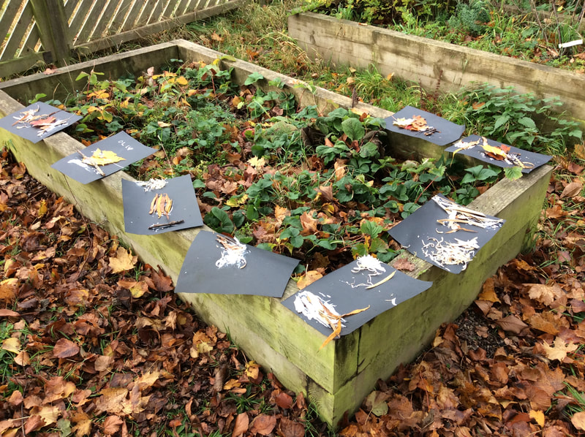
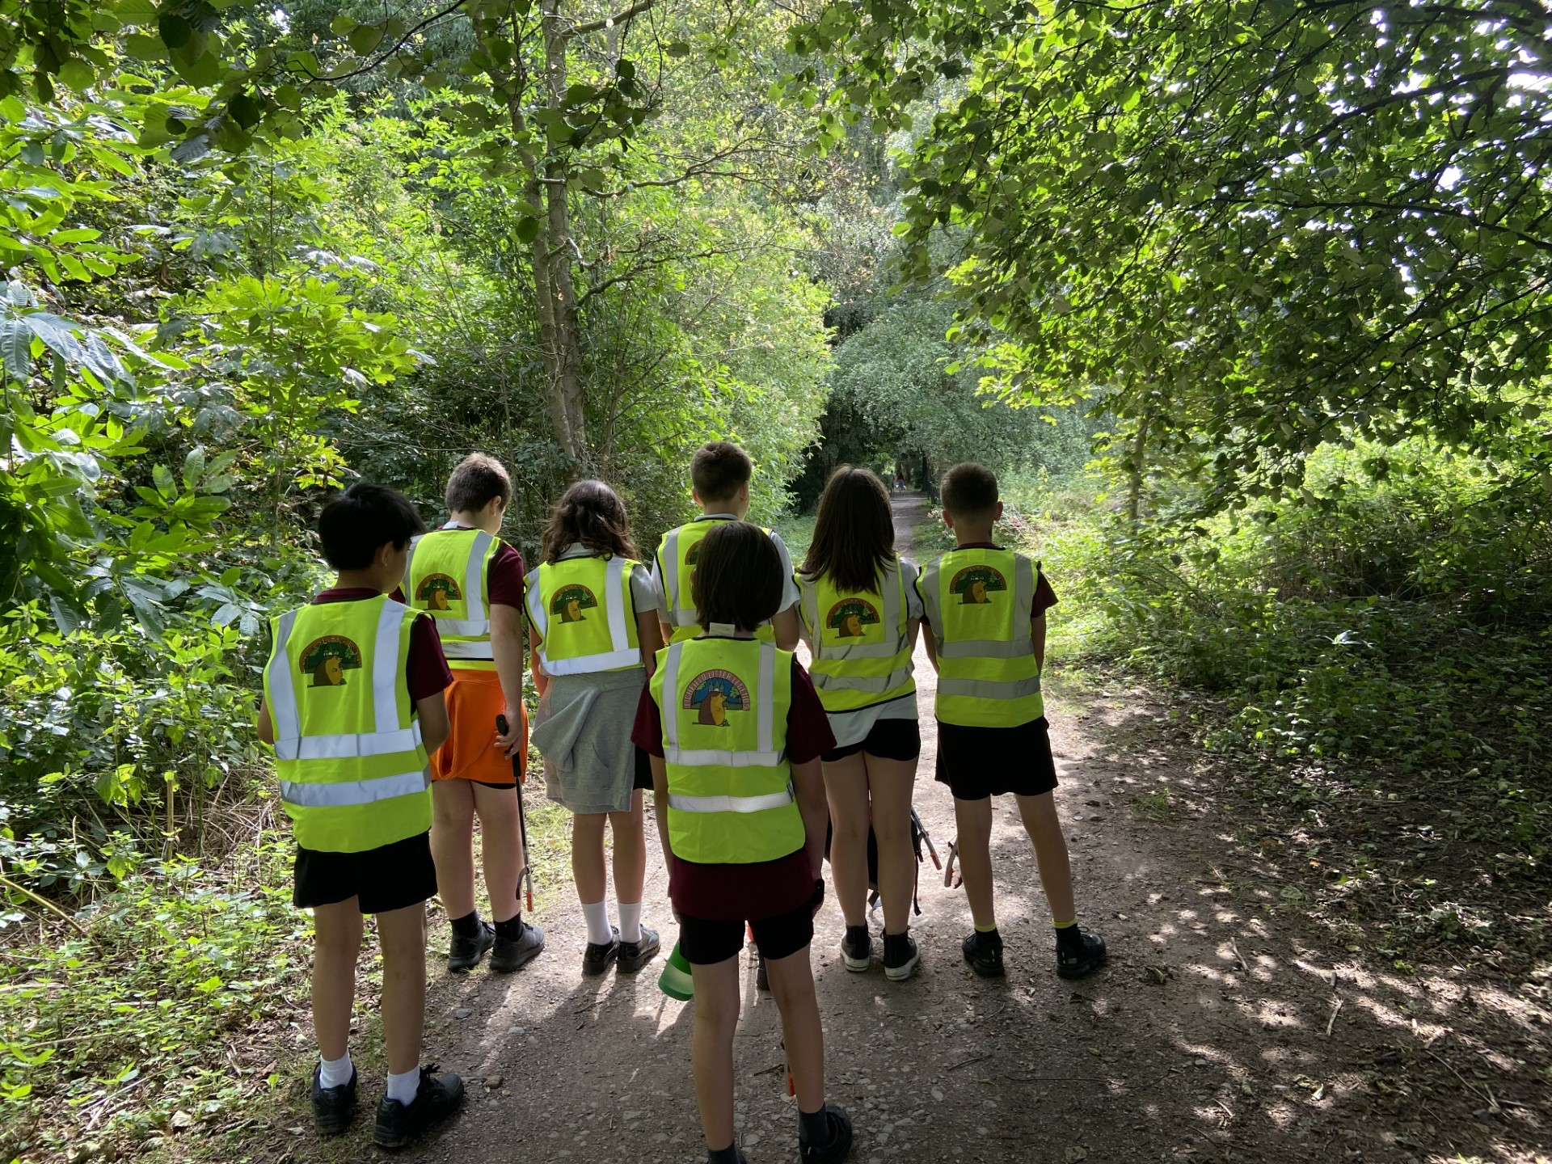
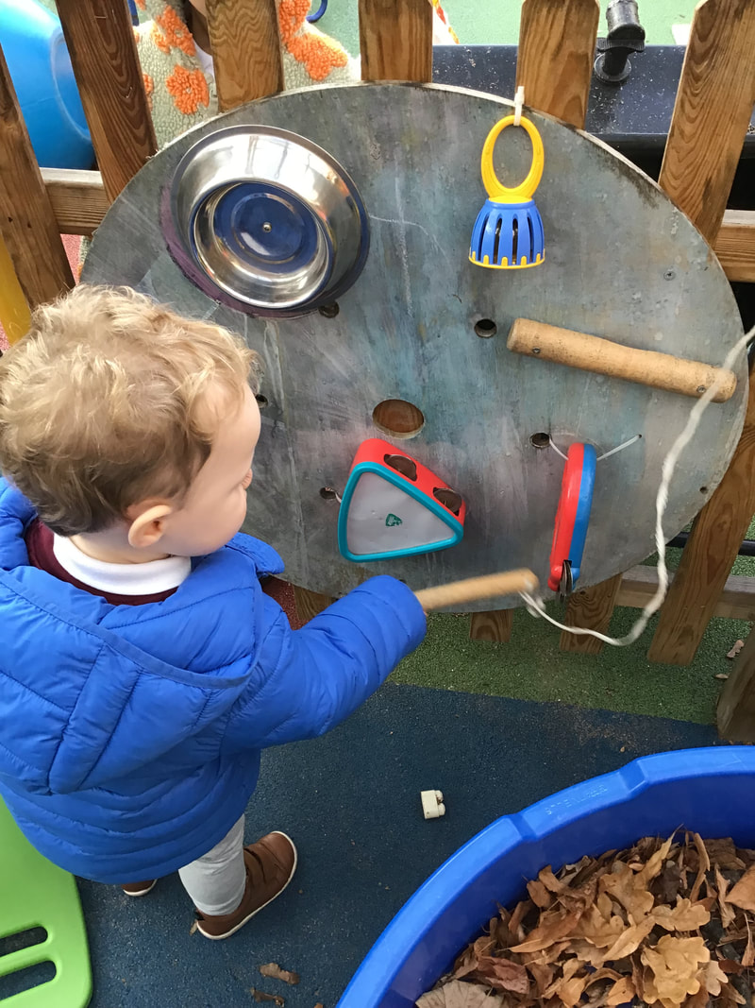
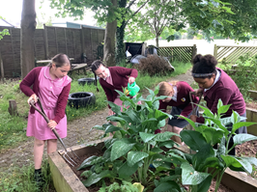
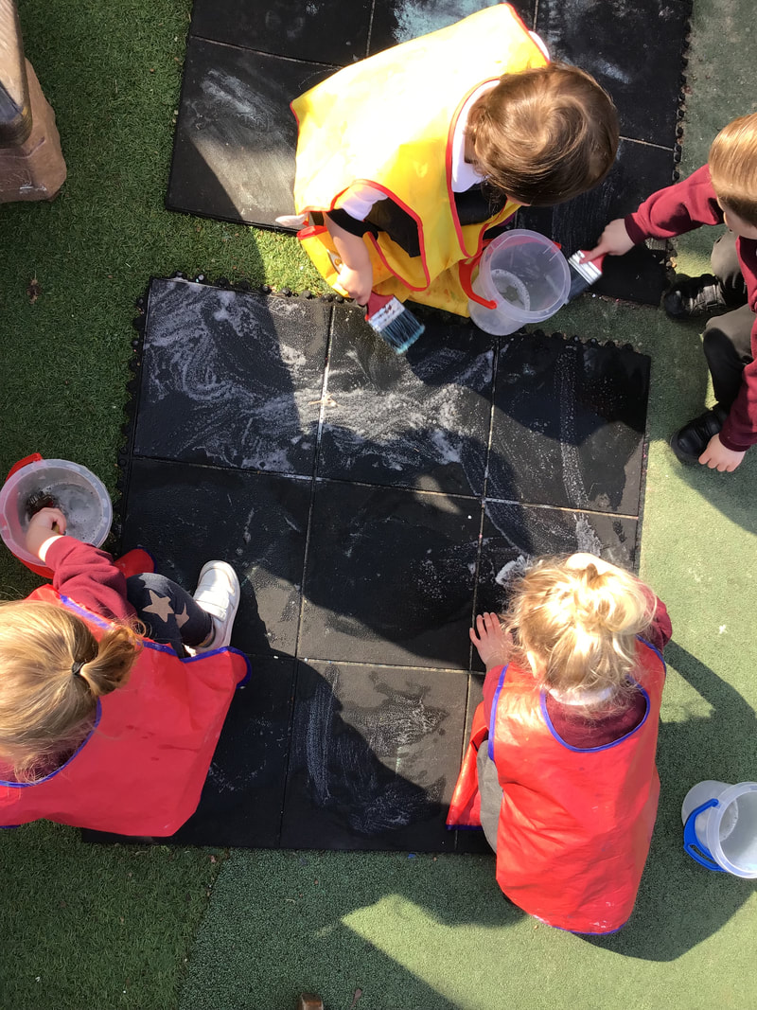
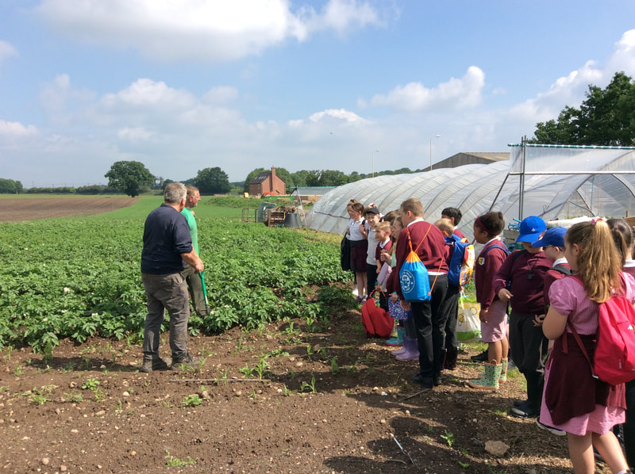
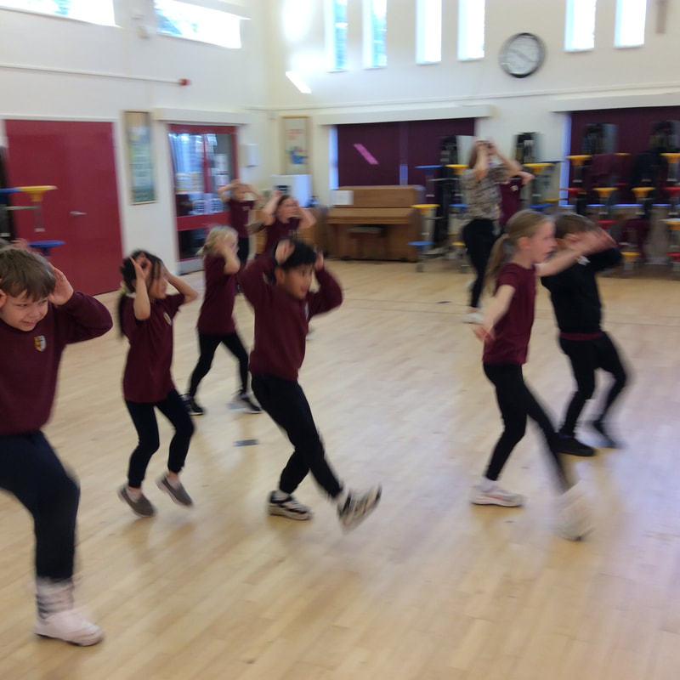
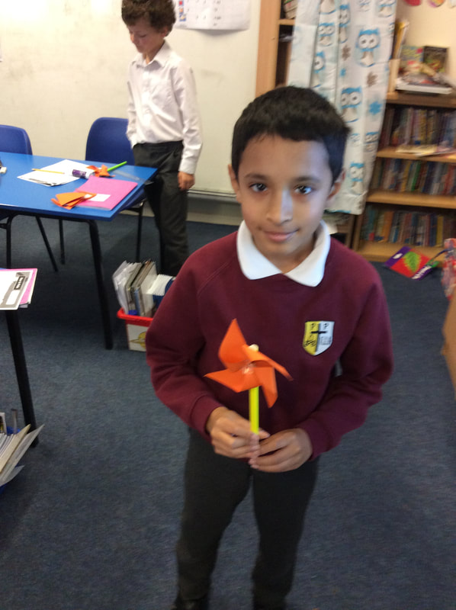
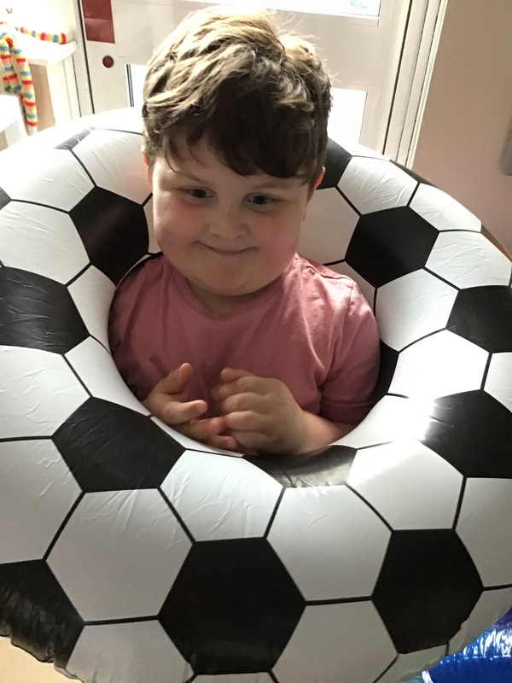
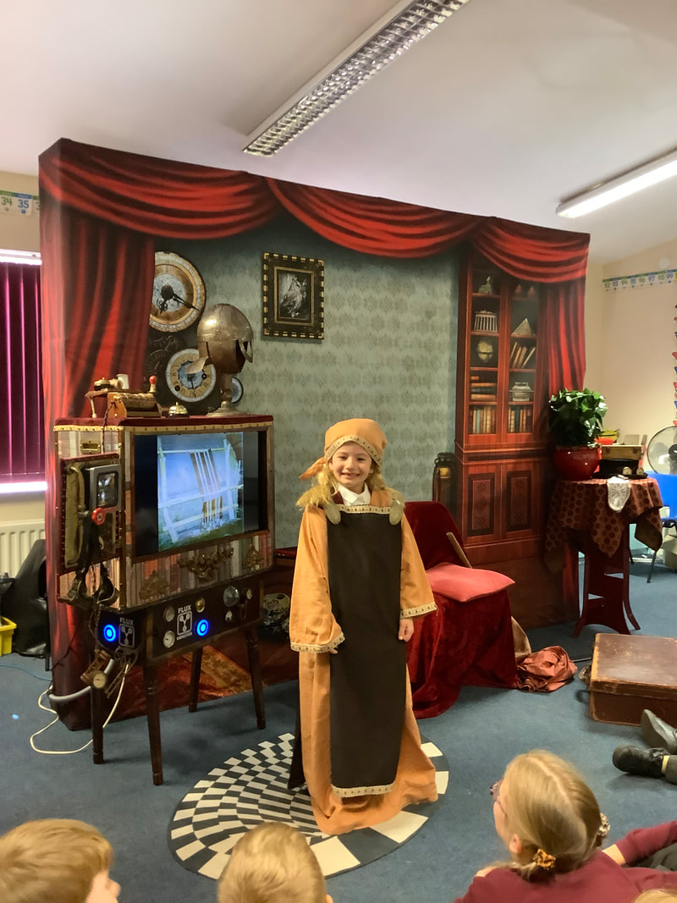
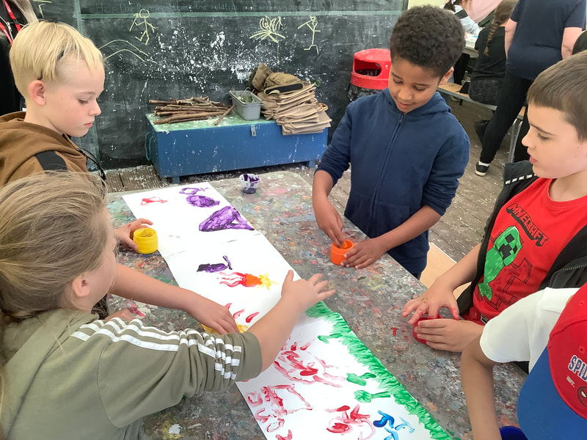
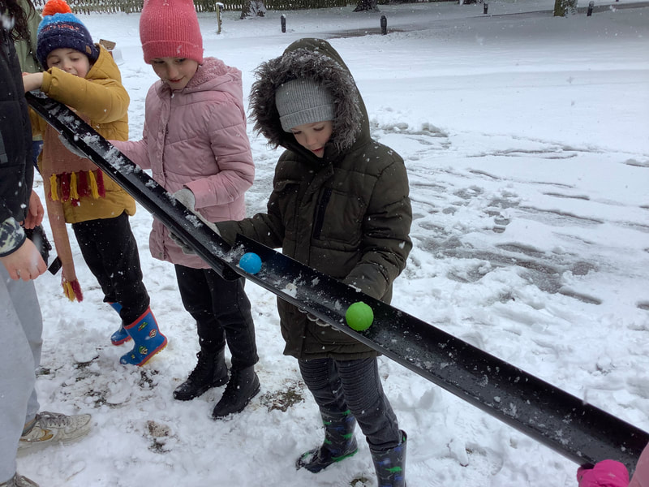
I Believe In Me.
Growing In God’s Grace.
SS Peter and Paul School Development Plan
2023-24
Learning Something New Every Day.

Slide 2
Growing Strong in God’s Grace
Training for newly appointed RE lead
Higher order questioning
Safeguarding
Inclusion
Further development of children leading prayer and liturgy
Strengthening parish links
Academy conversion
Challenge across the RE curriculum
Development of chaplaincy
Strengthening the Catholic life of the school
Ensure opportunities for Reconciliation for the children through the year

Slide 3
Learning Something new Every Day
Improving pass rate in phonics
Improving percentage of children achieving ARE at the end of each key stage
Coaching and CPD to upskills all TAs to deliver effective intervention and support for all children.
Using tutoring to action children who need further support to gain ARE at the end of the academic year.
Robust monitoring and assessment to quickly identify and impact on any identified weakness in teaching.
To ensure the governing body have a solid skills set to challenge and support the school appropriately
CPD and coaching for subject leaders to ensure they have a sound knowledge of their subject and are able to action positive change and measure for impact.
Robust monitoring by subject leaders to identify weakness and implement support/ change

Slide 4
I Believe in Me !
Mental health support for pupils and staff
Improve attendance across the school
INSPIRE sessions for parents and children to celebrate success and learning
Further develop nurture provision
Further develop forest school and develop the school garden
Social and emotional targets for children who require extra support
Look at the development of play and opportunities for equipment on the school playground
Further develop sensory opportunities for those children who need it.
Rewarding positive behaviour and good role models
Ensuring opportunities for the children to take on roles and responsibilities

