Slide 1
SS Peter and Paul Catholic Primary school
CAFOD Live Simply Award.

Slide 2
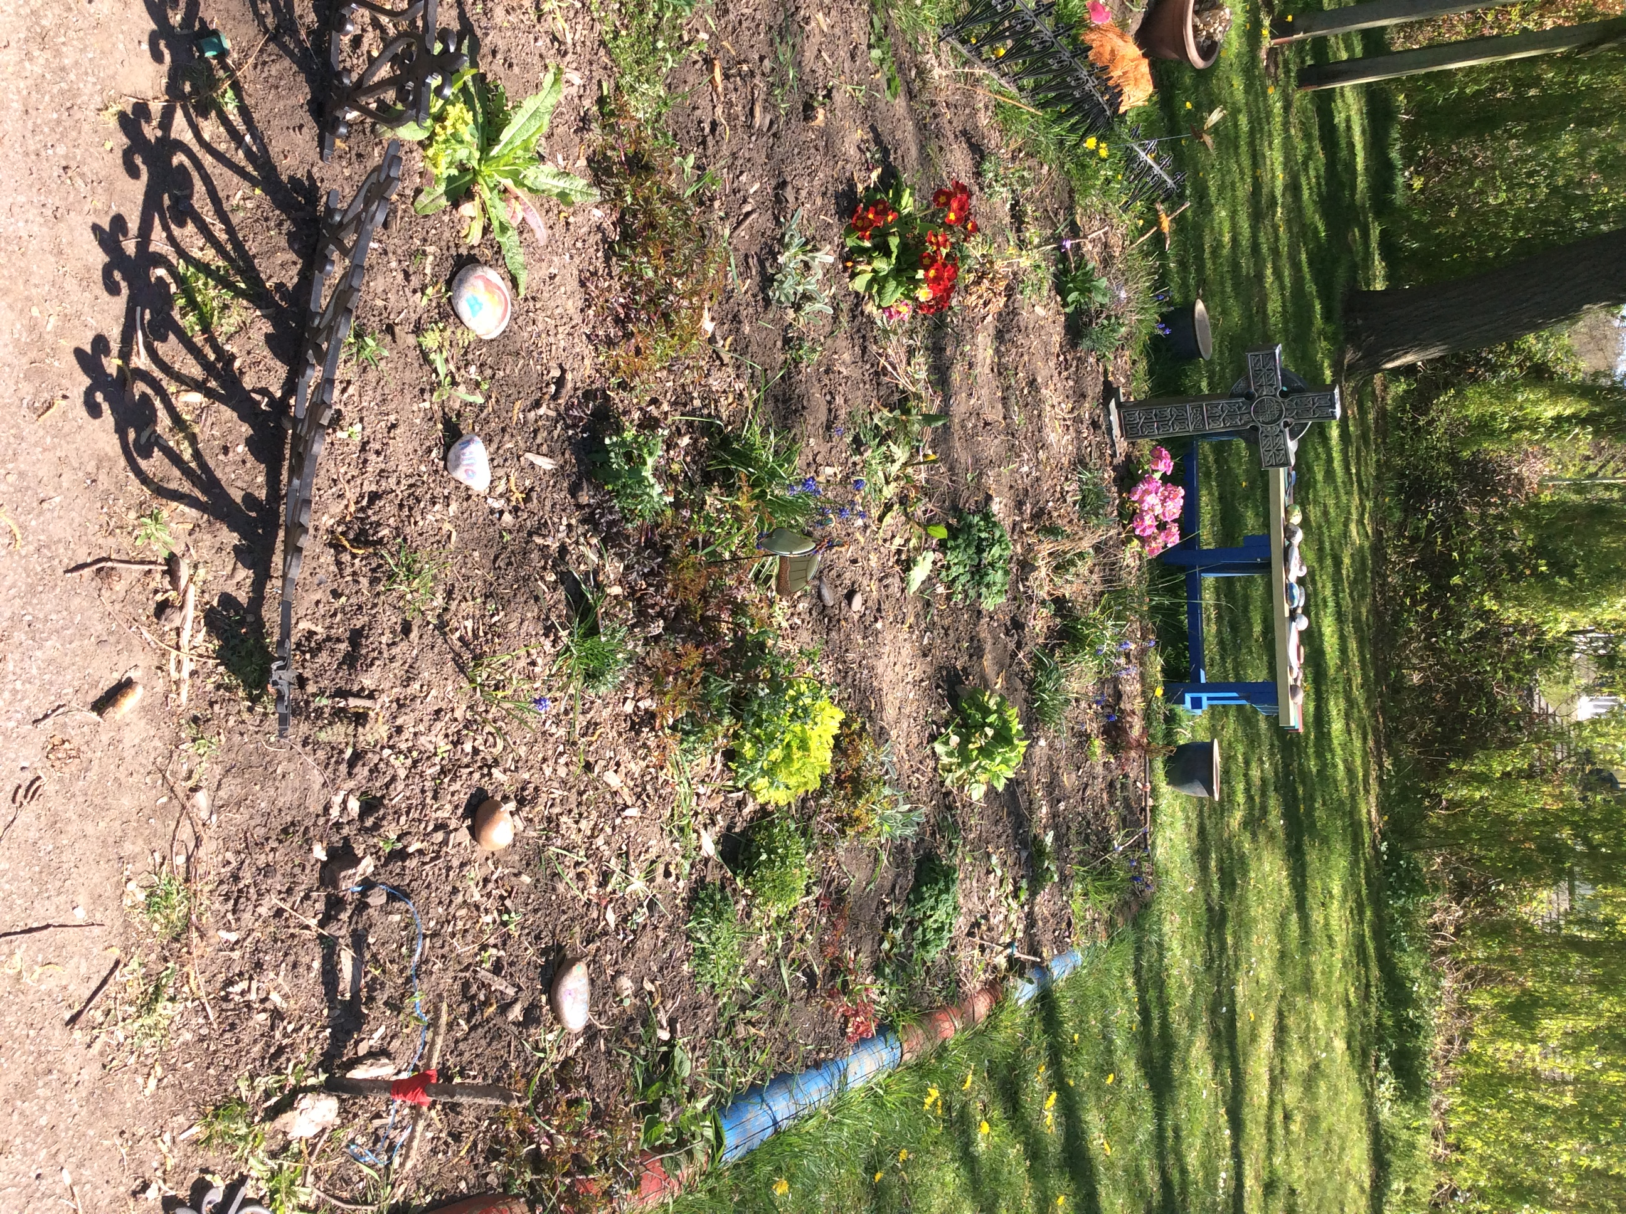
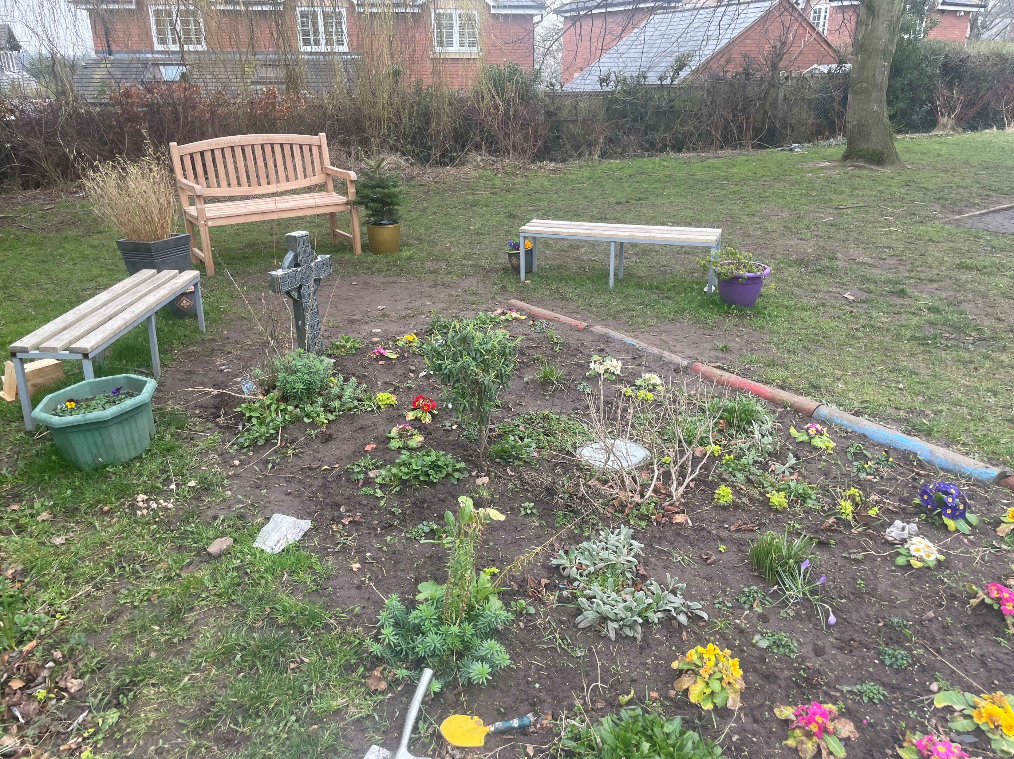
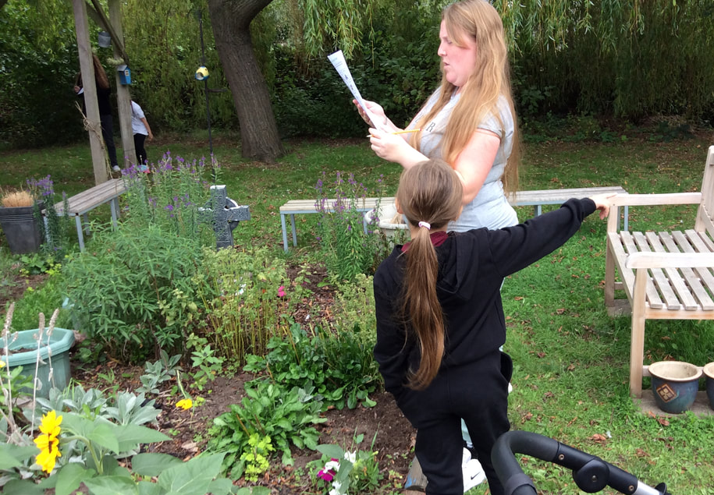
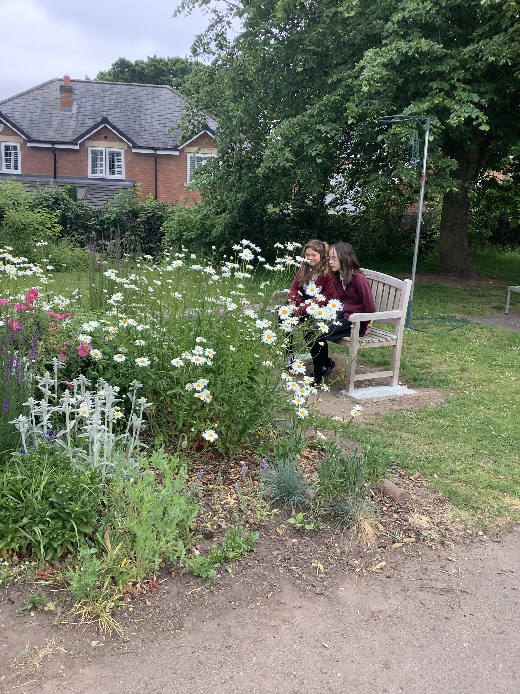
To Live Simply
Create a prayer garden for the children to use for peaceful reflection.
To create the prayer garden for children to use for peaceful reflection
The prayer garden will be a place of quiet reflection that children can use at break times and where appropriate during lessons
Children use the space for quiet time at playtimes. There are several children who work with an adult to maintain the prayer garden, they plan seeds and regularly weed and care for the area. We use it for short prayer services and as a location for Stations of the Cross. The garden was also used in our Creation sessions with parents.

Slide 3
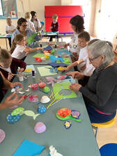
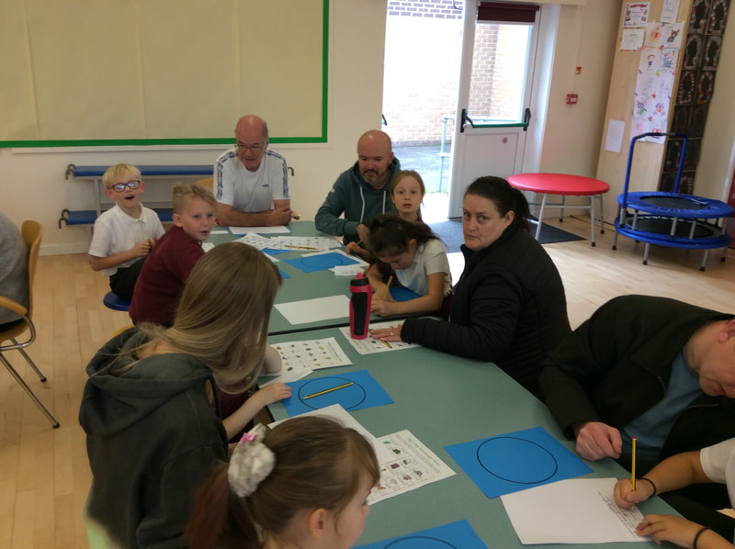
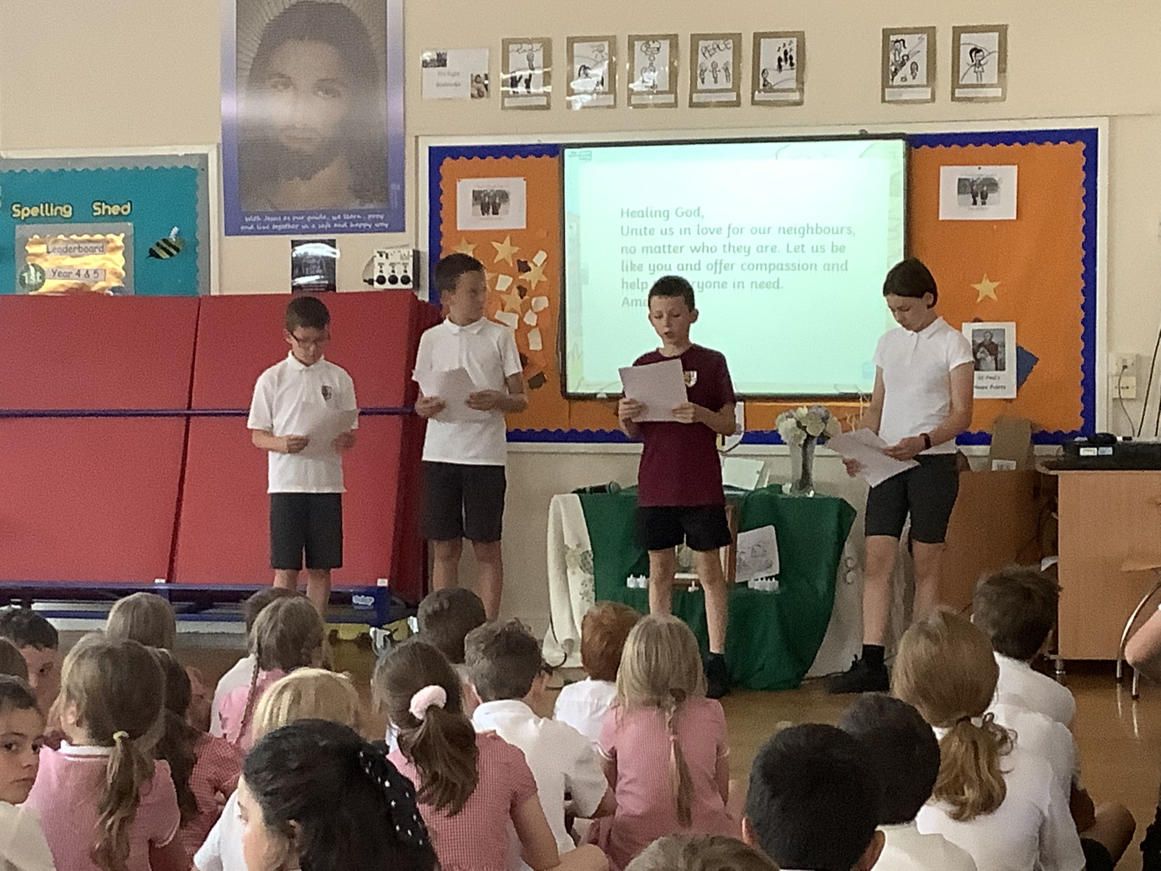
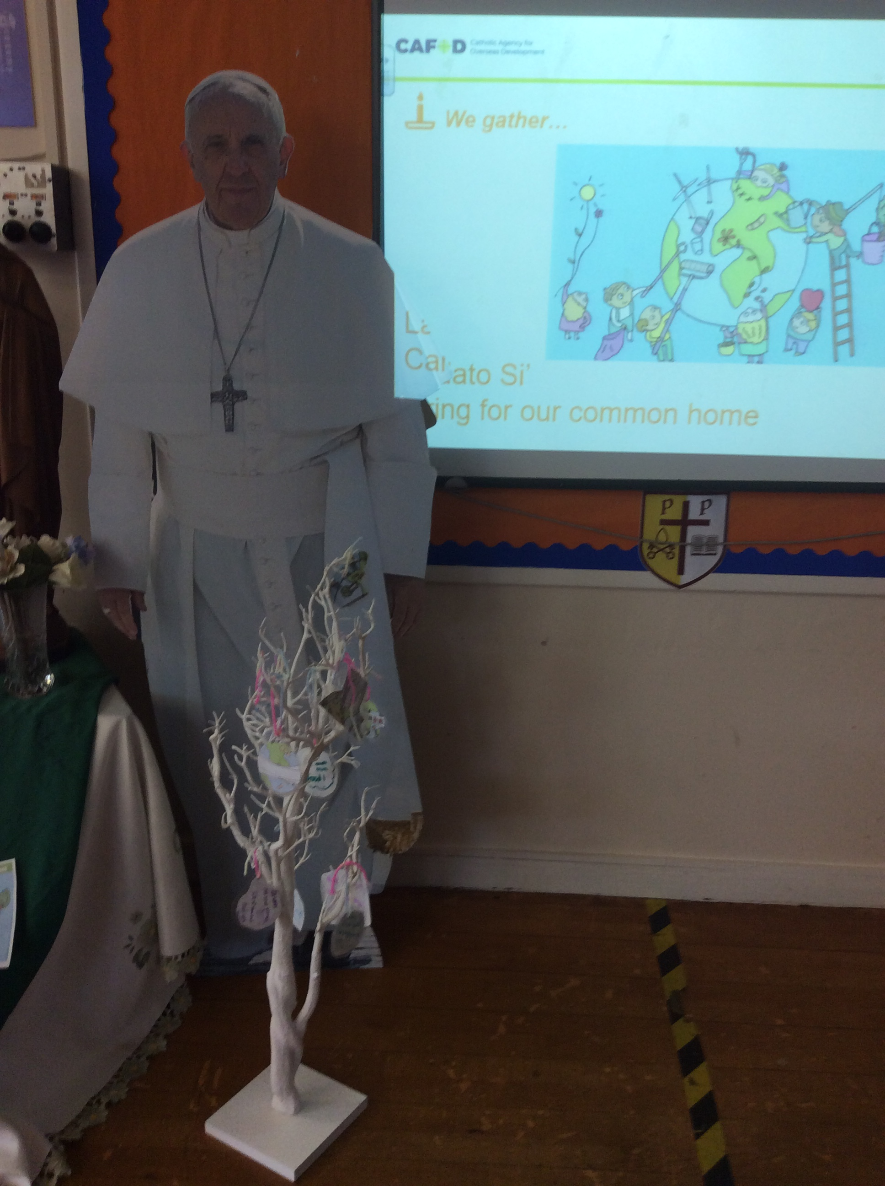
To Live Simply
To share the Laudato Sii assembly with the children.
To share live simply ideas with parents
We had INSPIRE workshops for all parents about Creation and how we need to care for it. As a school we put notes in the newsletter about how to live simply
Some of the children led the Laudato Sii assembly for the rest of the school. The children were all given the colouring sheet to complete after the assembly with ideas how they could live sustainably.

Slide 4
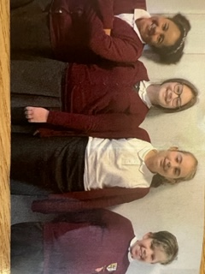
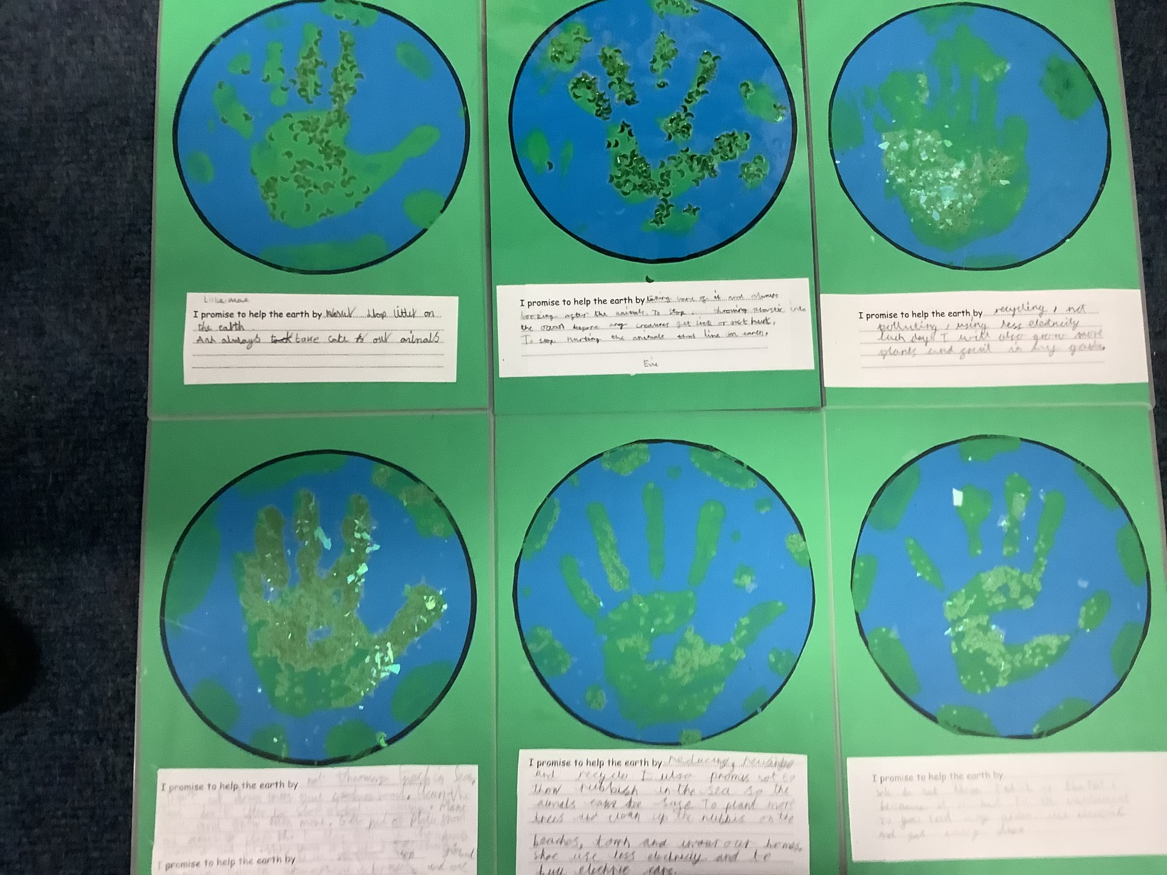
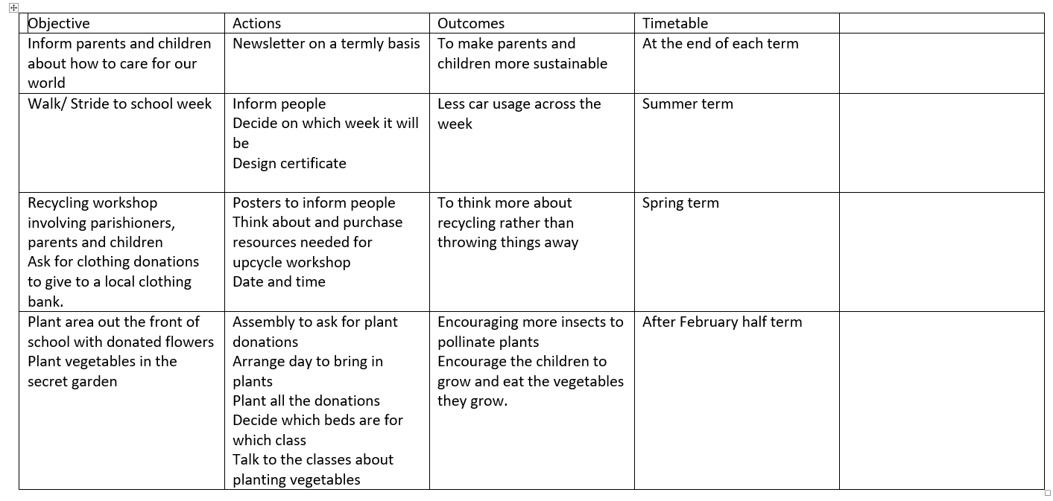
To Live Sustainably with Creation
Set up a school Eco club to help raise the profile of living sustainably
The eco council have created posters about caring for our world. They have encouraged children to be involved in litter picking around the school. They helped to organise and run the Christmas toy swop event. They have also organised a uniform free shop for the end of term.
They have put together their own action plan for further events in the year, to carry on our sustainability

Slide 5
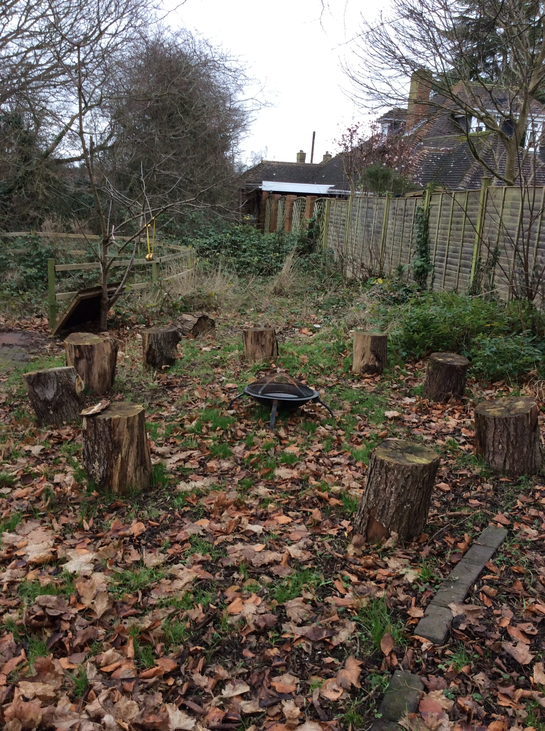
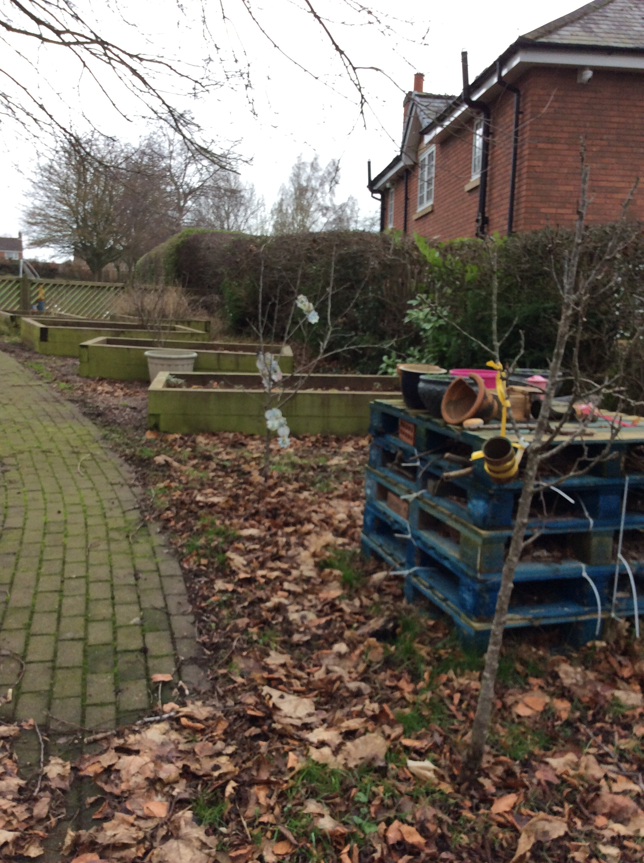
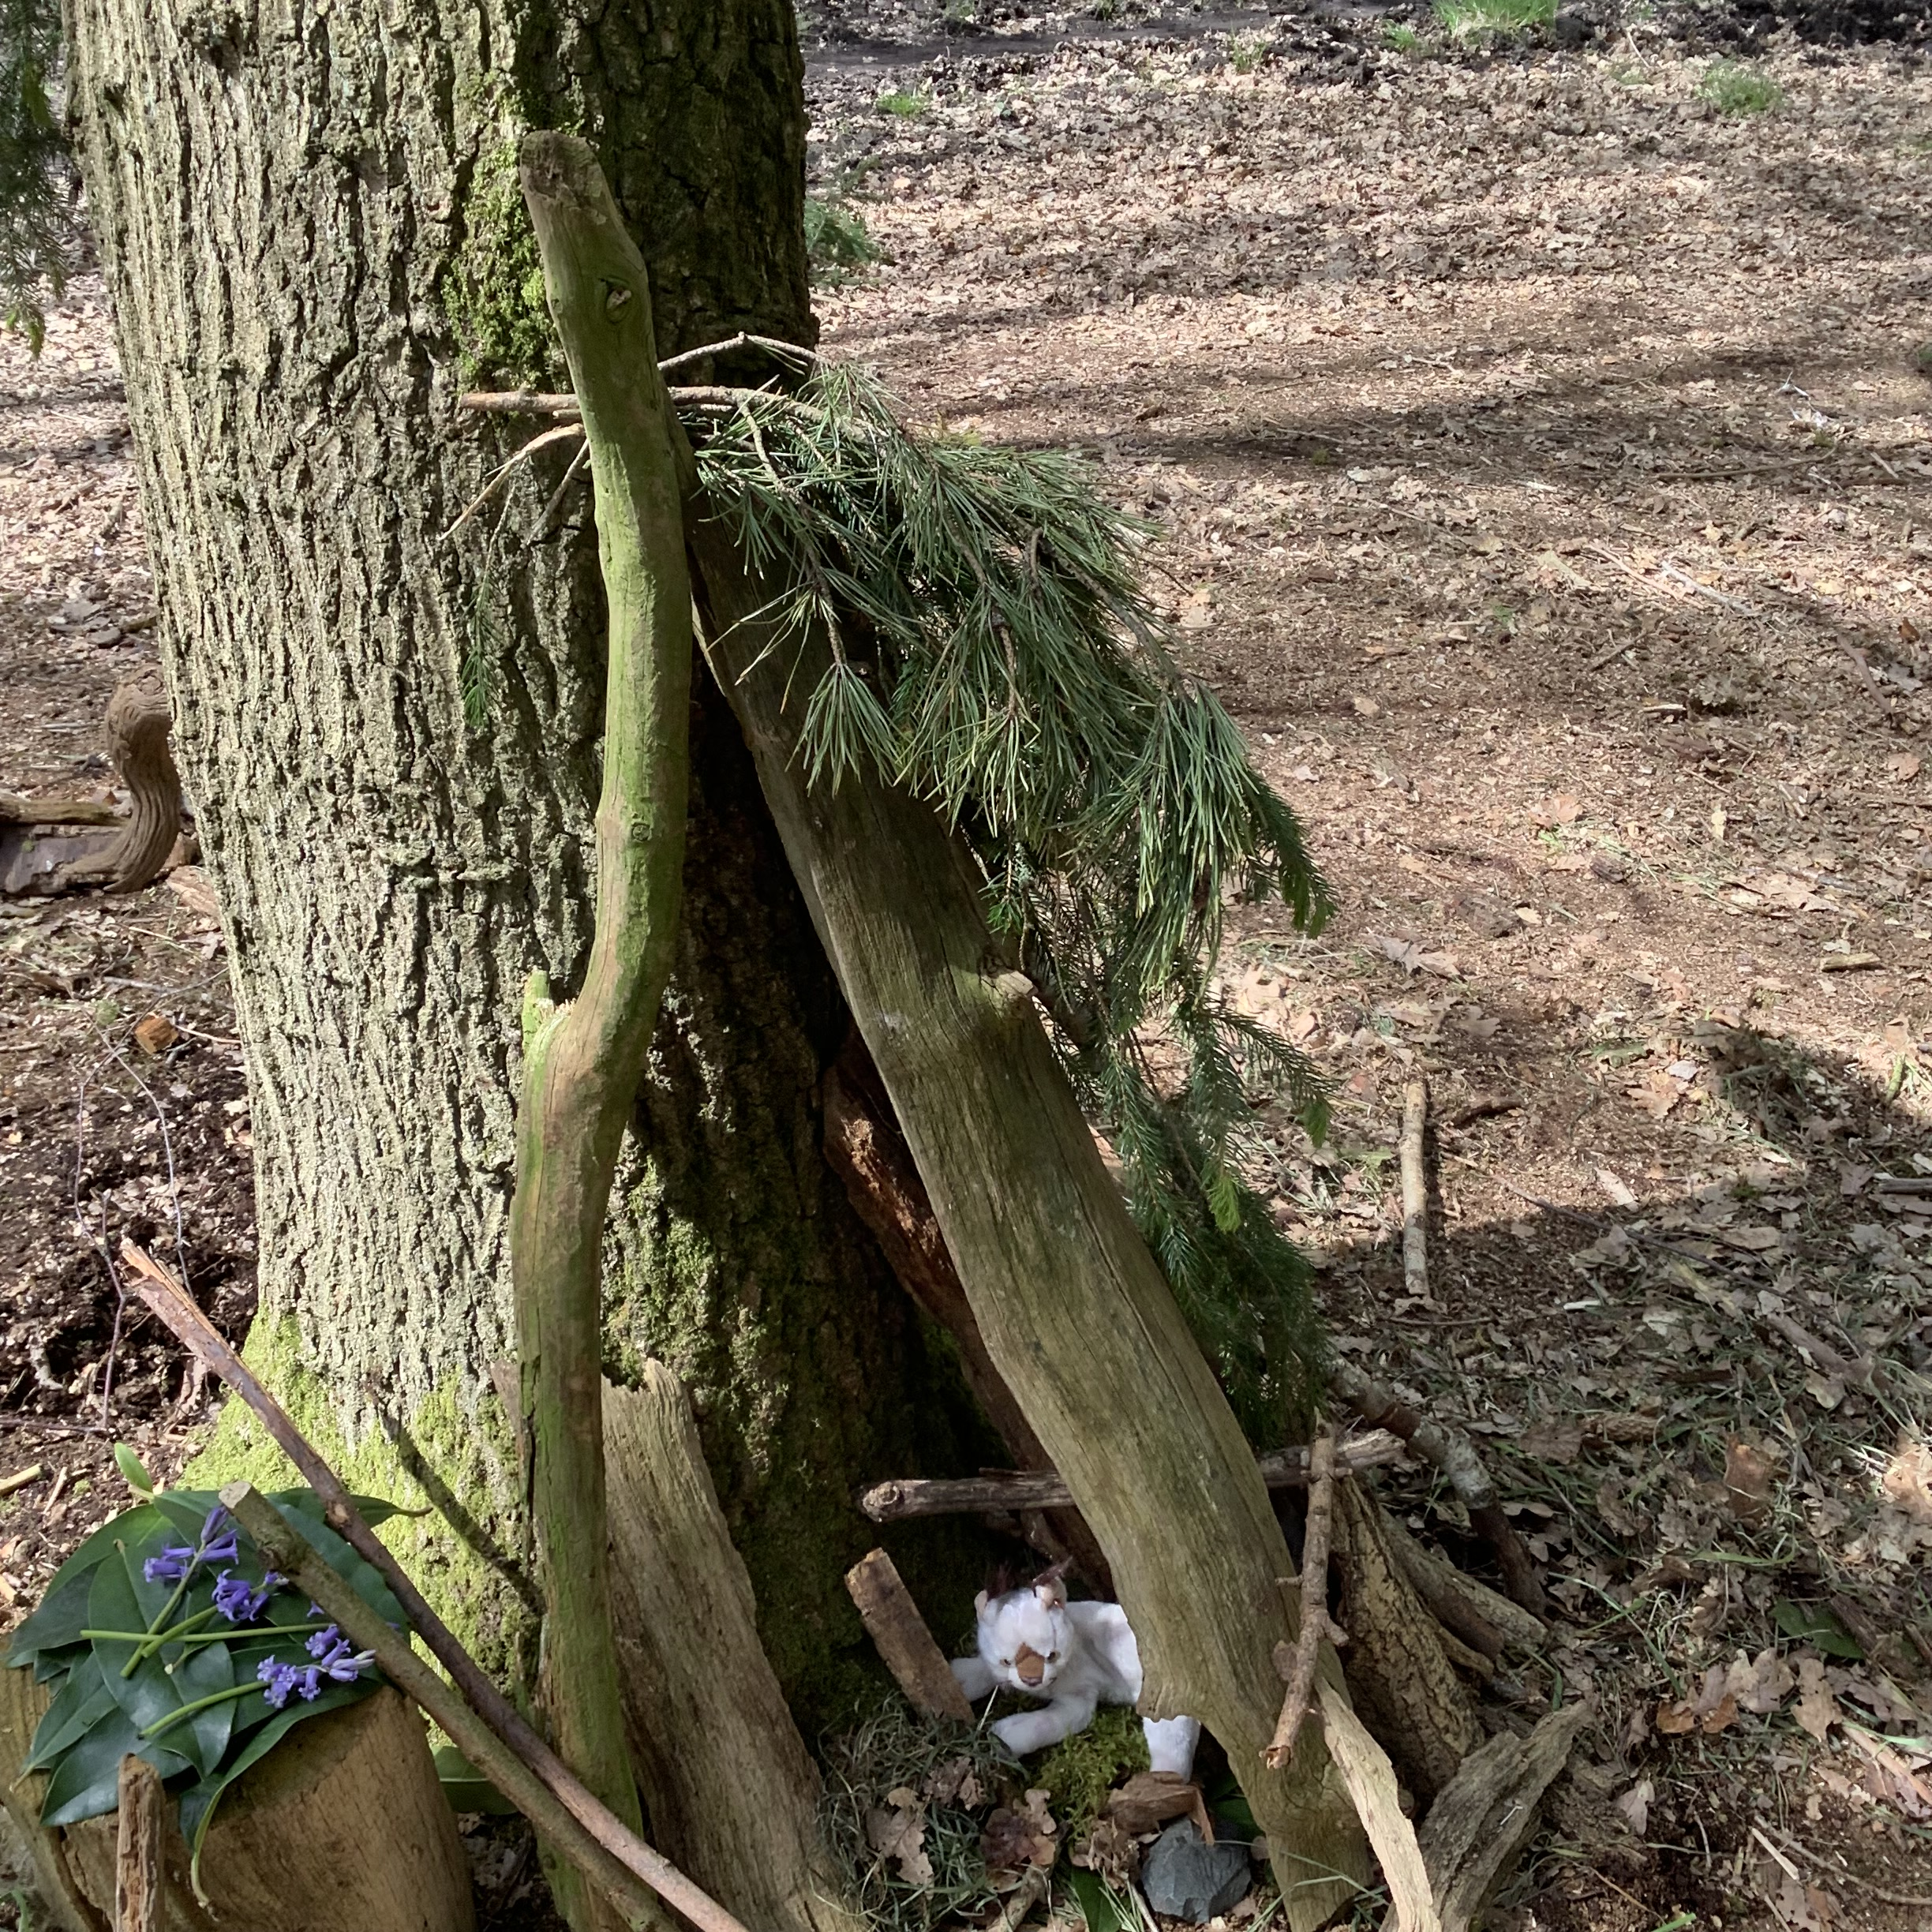
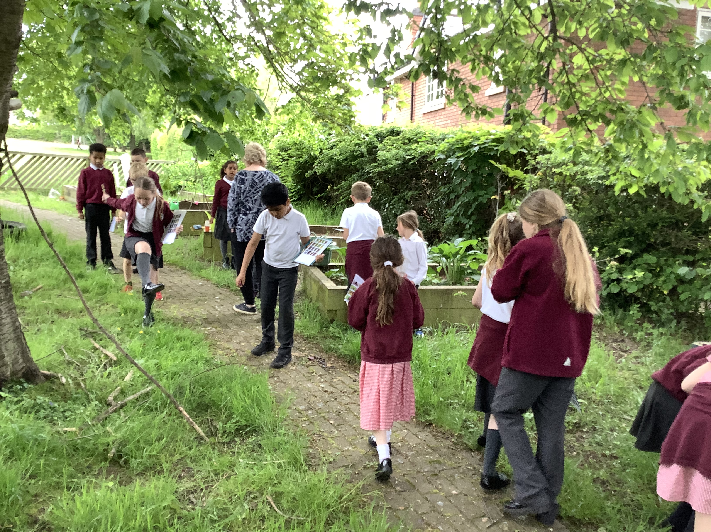
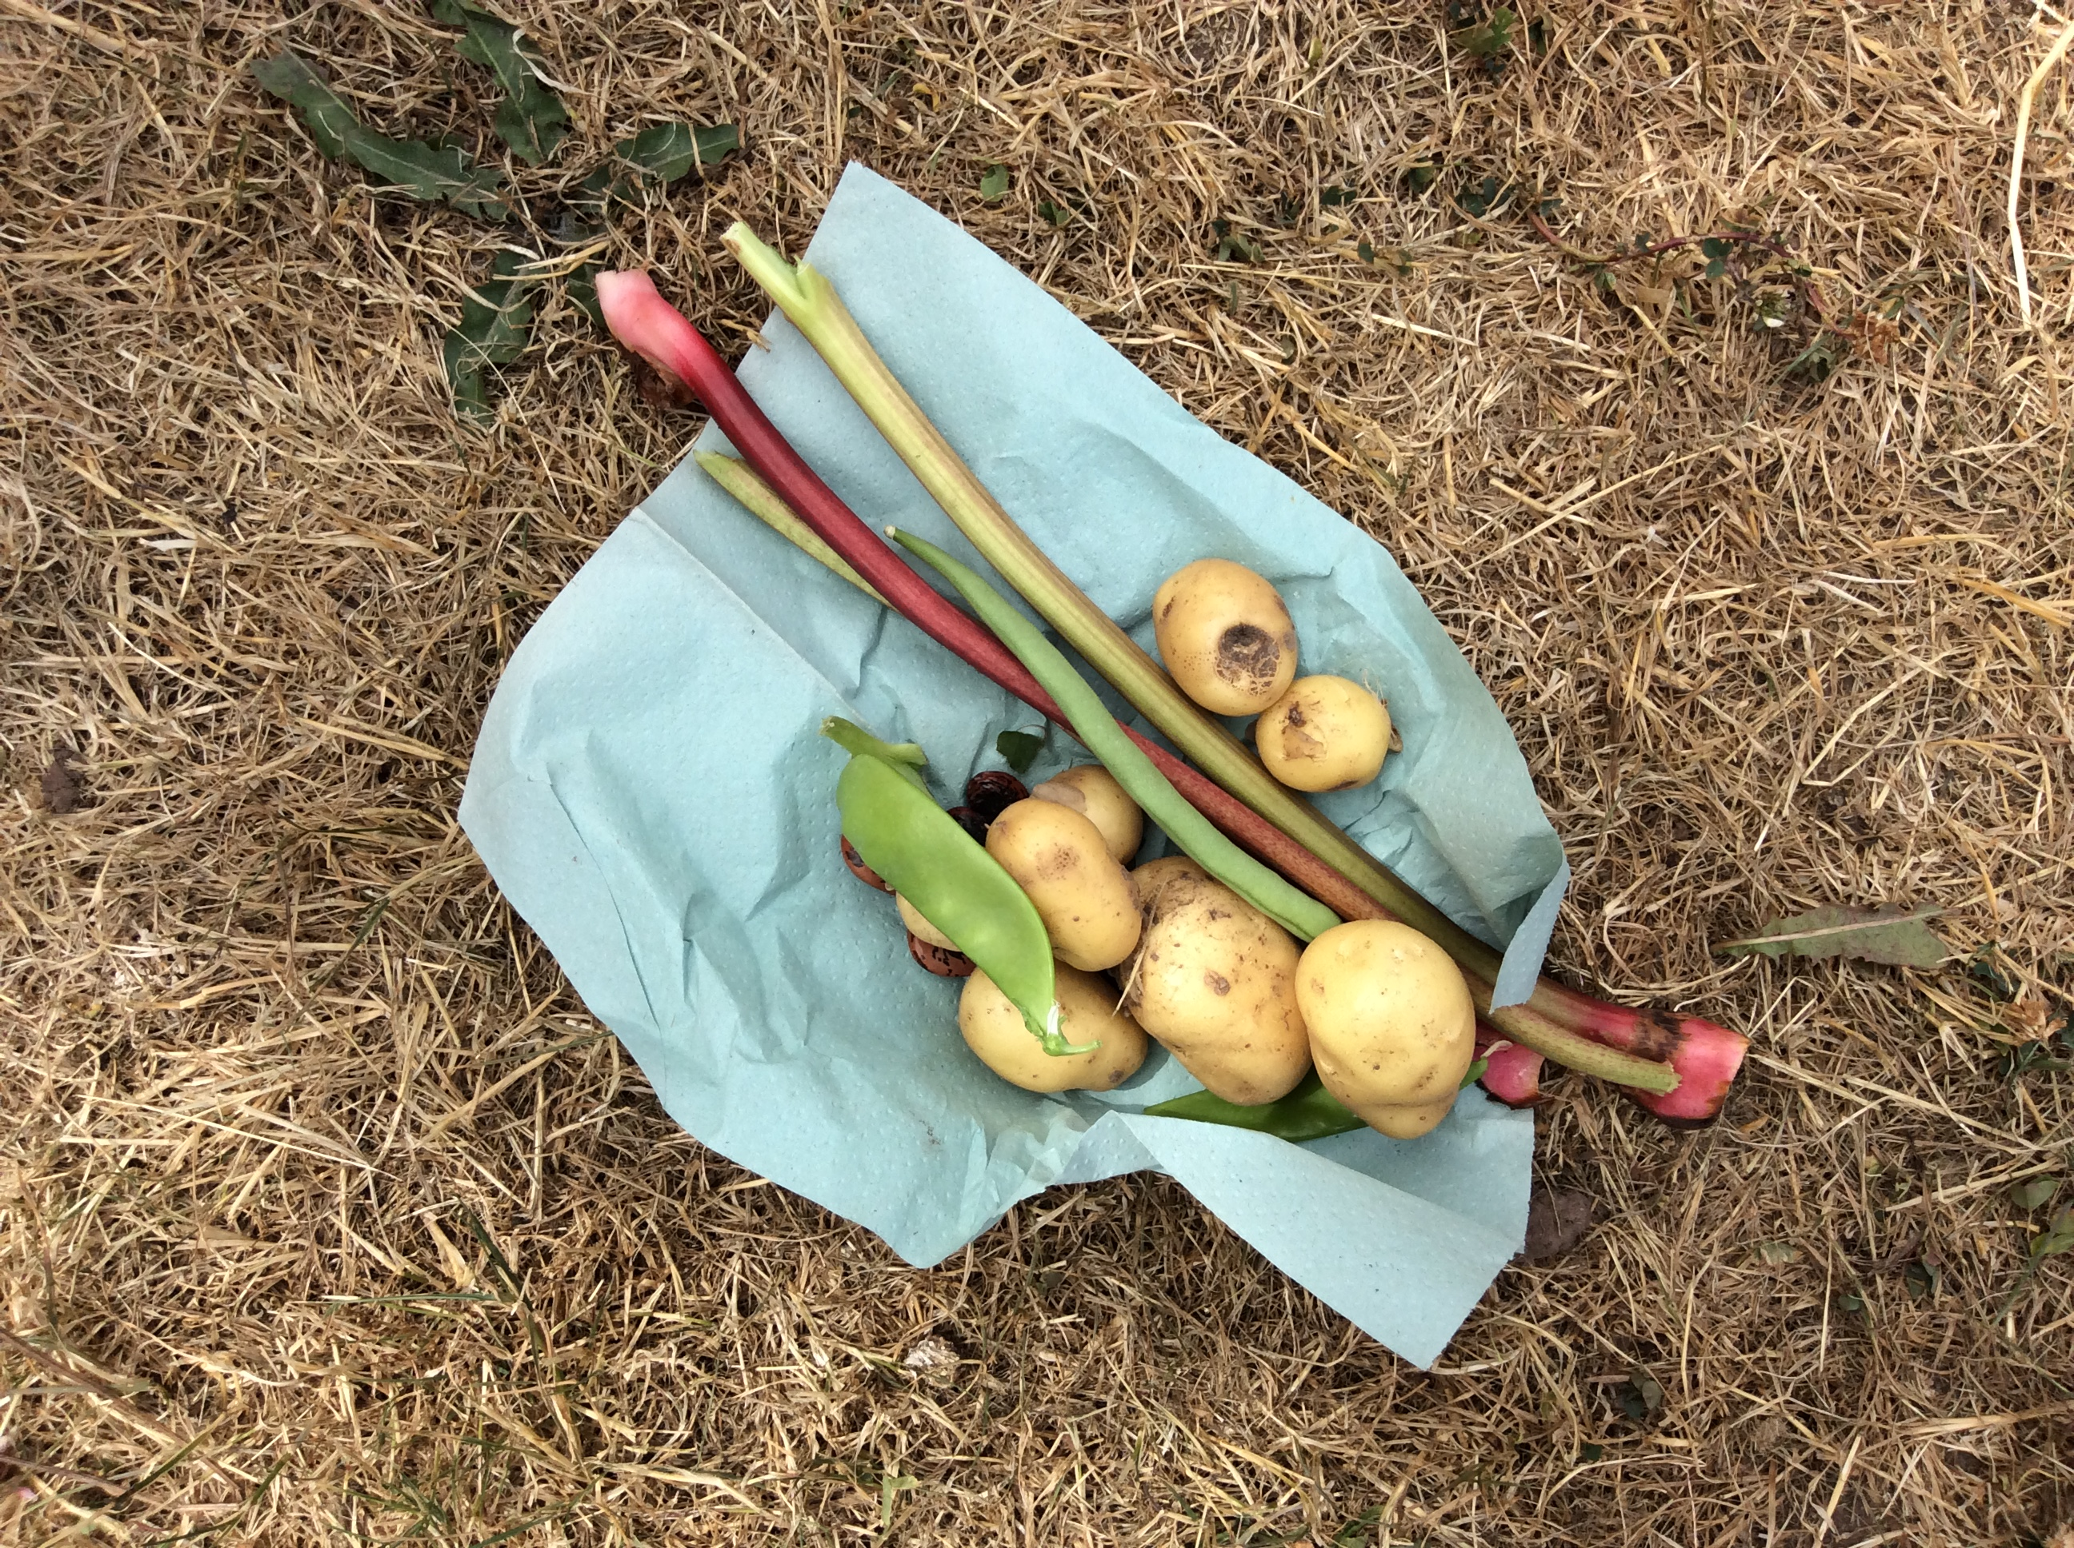
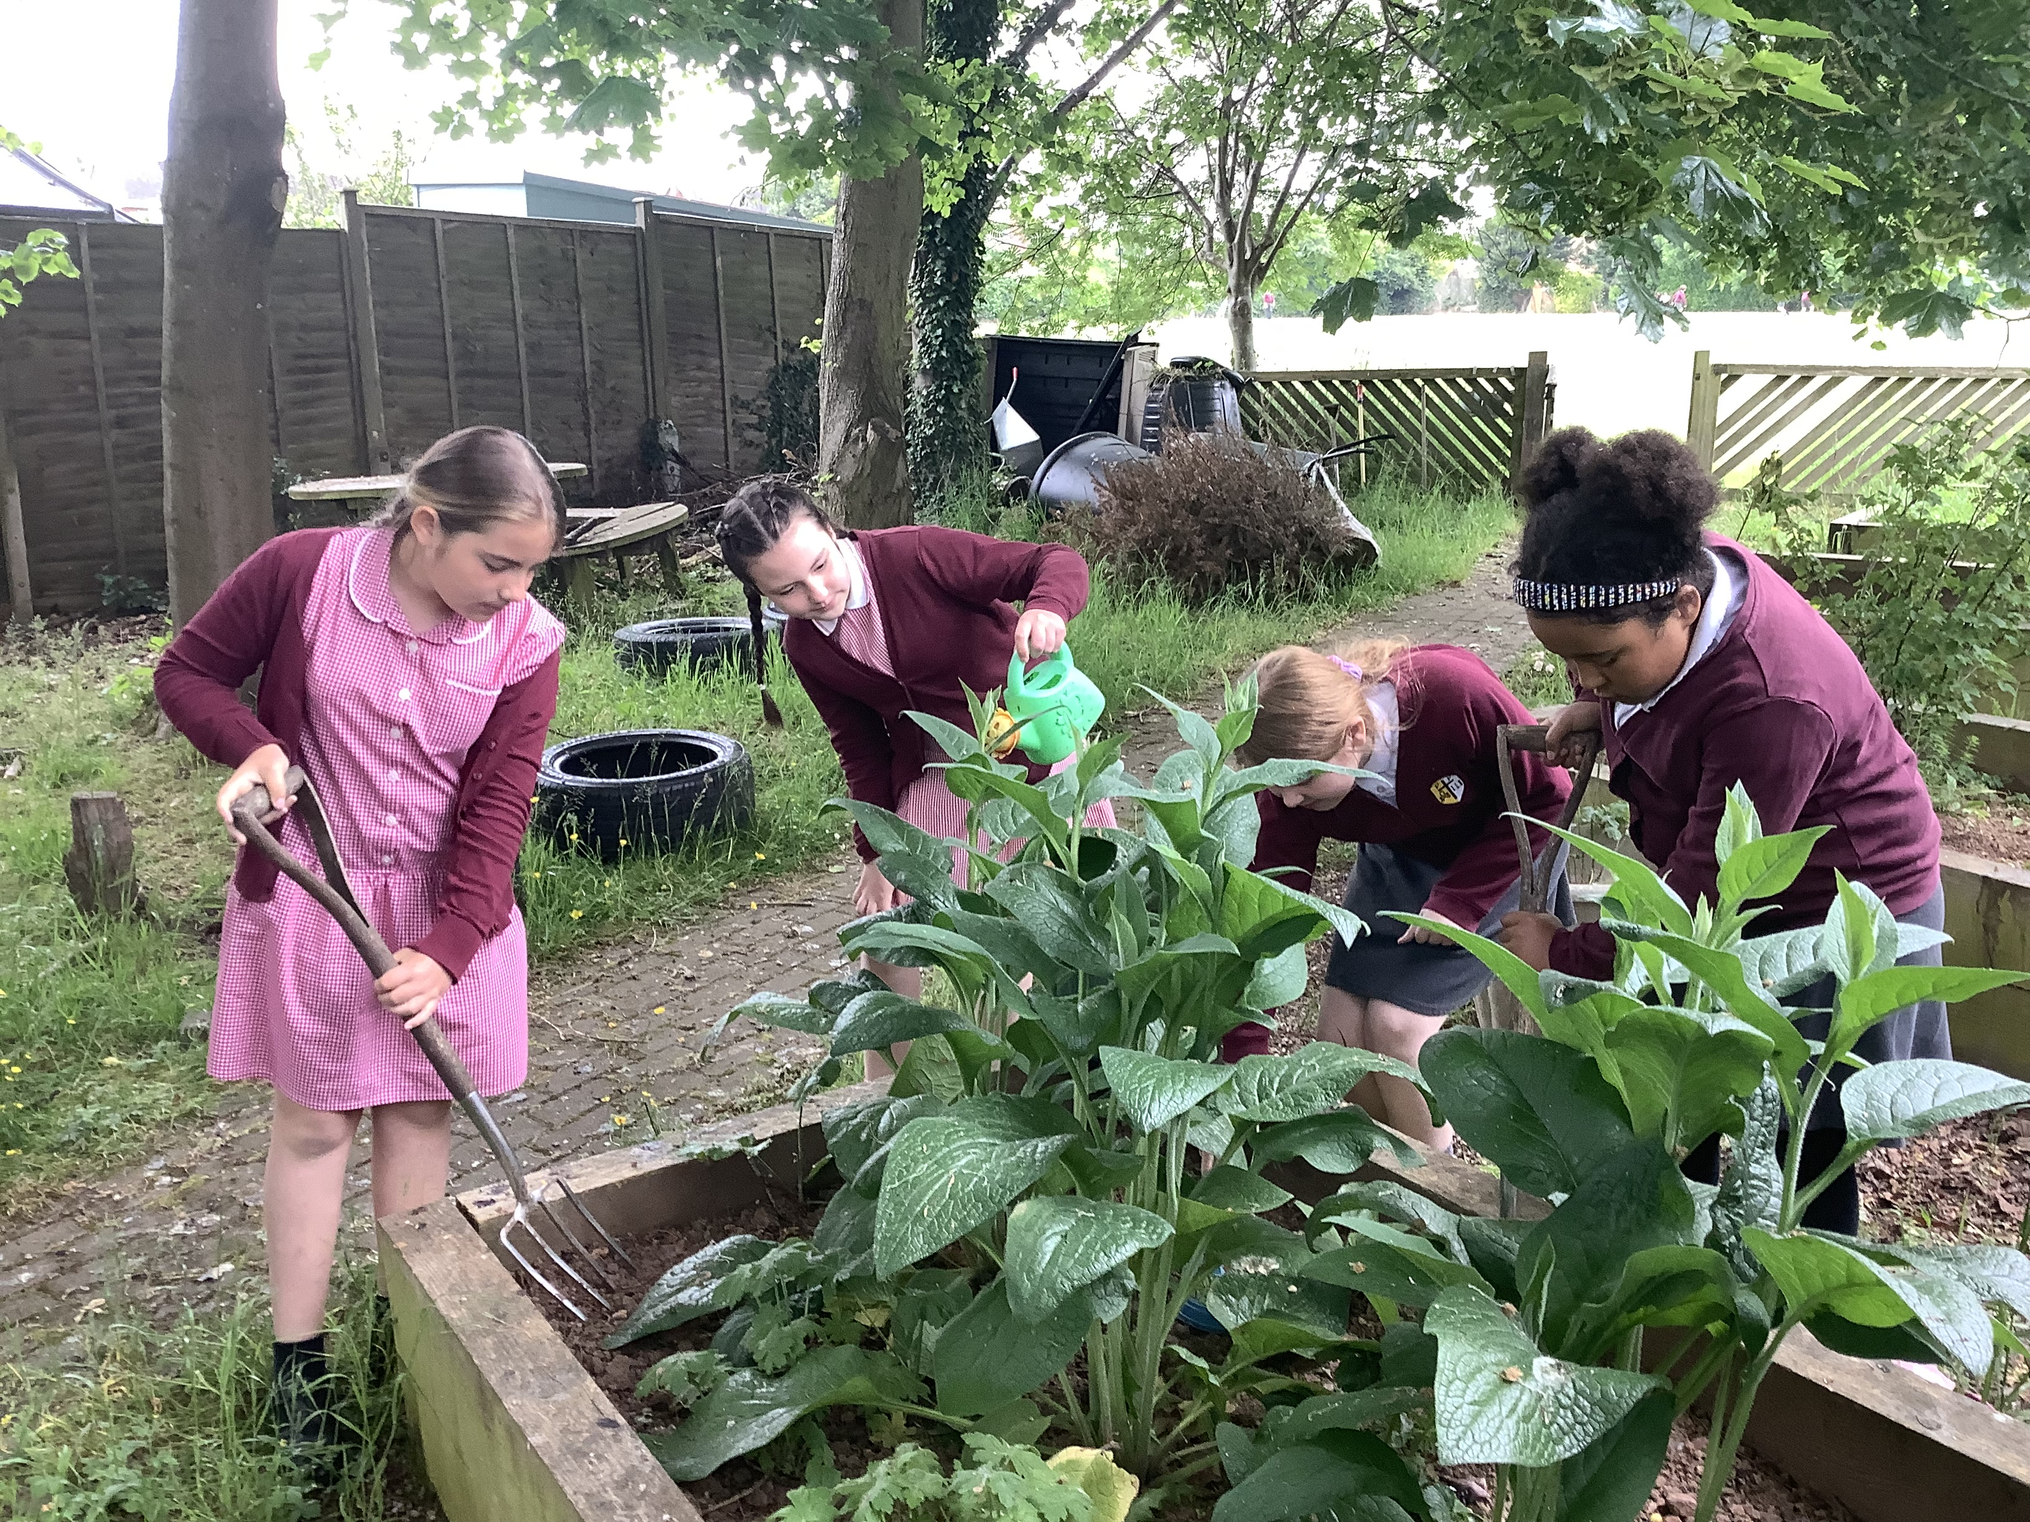
To Live Sustainably with Creation
To hold a walk/ cycle to school week in school.
All children encouraged to walk, cycle or scooter to school during the last week of June, the Eco
Council created a poster and a record sheet for the event. All children received a book mark
To set up forest school sessions in school
Forest school sessions started with children who are the quieter members of our classes. It gives them an opportunity to
have a voice and to help to understand how to look after our school garden
For all classes to have an area to plant flowers or vegetables in the school garden.
Classes have planted and cared for some fruit and vegetables in the school garden, such as
rhubarb, potatoes and strawberries

Slide 6
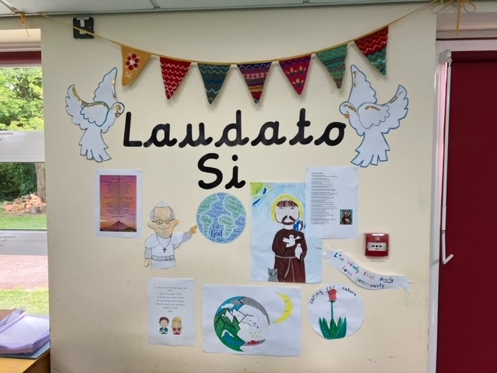
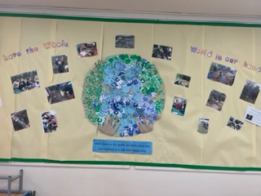
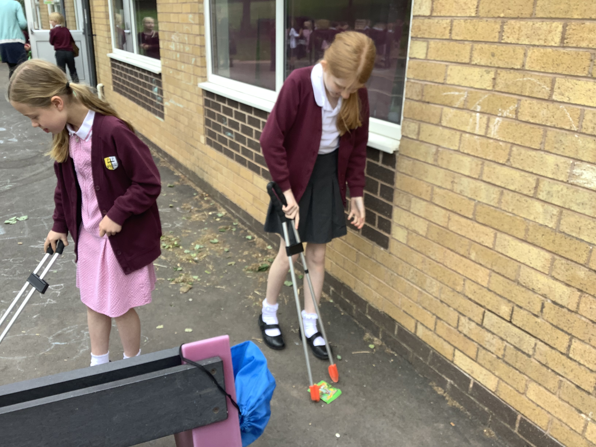
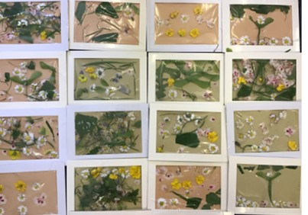
To Live Sustainably with Creation
To have children doing litter picks at playtimes and lunchtimes to keep our school environment litter free
Any child can help to keep the school clean, litter pickers are available at every break time for the
children to freely use around the school
Y6 extended this to join Lichfield litter pickers to carry out a litter pick in the local park with a local group called Lichfield Litter
legends.
To set up recycling in every class
Our Y6 children have set up a recycling box in every room , these are collected and emptied
weekly by the Y6 children, helping our school to be better at recycling
To work with partnership schools to have a cross school Ladauto Sii week.
All our partnership schools (10) planned a celebrating God’s creation week at the end of May. We all had an assembly based on caring for God’s world, attended a virtual joint Mass and carried out activities across the week which celebrated God’s Creation

Slide 7
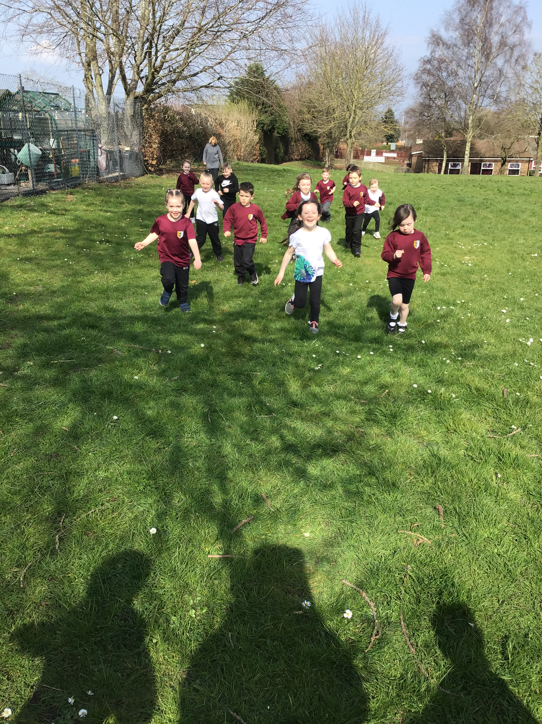
To Live in Solidarity with the Poor
To join the CAFOD Walk for hunger campaign.
All children in the school were involved in walking a marathon from Lent until the end of the Summer term. The children gained sponsorship and walked a couple of circuits of the school field every day. They all gained a medal for their efforts and we raised a whopping £659.64 for CAFOD.

Slide 8
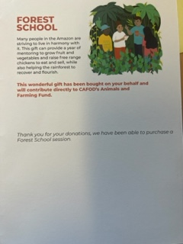
To Live in Solidarity with the Poor.
Collection of harvest goods for the local food bank – The children donated 212 meals.
Staff made donations towards
CAFOD for a world gift, rather
than sending out individual
Christmas cards. We were able to
purchase a Forest School session.

